Slide 1
Front End Development
Task-2

Slide 2

Front End Development
Using HTML & CSS we have developed a front end web page based on education purpose. In full-stack development, front-end development is typically focused on creating the visual and interactive elements of the application that users interact with.
LMS Username | Name | Batch
2115a827 | RANJITH V | A8_13
2115a84 | DEEPAKRAJAN R | A8_13
2115a822 | MOHAMMED JAMALUDDIN S | A8_13
2115a844 | SUNDAR K | A8_13

Slide 3
INTRODUCTION
In full-stack development, front-end development is typically focused on creating the visual and interactive elements of the application that users interact with. Web client-server architecture is responsible for handling user interactions and displaying data.

Slide 4
HTML -
HTML is used to create the structure of web pages; and Bootstrap is a popular CSS framework that provides predefined styles and layout options. JavaScript frameworks provide additional functionality and tools for building complex, interactive user interfaces. They are useful to create responsive, interactive, and efficient user interfaces.
Web client server architecture
HTML Structure Tags – Forms field
Bootstrap – React.Js
jQuery- ajax - Promises
API integration

Slide 5
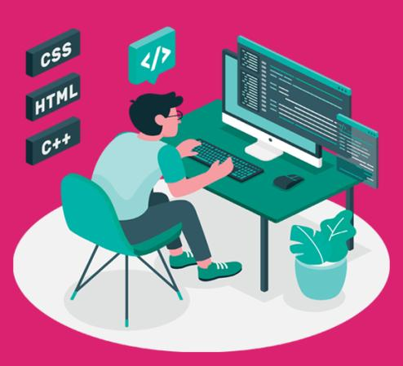
FRONT END DEVELOPMNENT
Developing a user interface webpage by using front end development.
Using HTML & CSS
For example we have developed a learing platform for web development ,etc….called CODETOWN by using “HTML &CSS.

Slide 6
CODETOWN
In this example, the page consists of a header, navigation menu, main content, and footer. The CSS styles are added in the head section of the HTML document.
The header contains the page title, and the navigation menu has links to different sections of the page. The main content contains three sections: About Us, Our Services, and Contact Us. The Contact Us section has a form for users to fill out and submit. The footer contains copyright information.

Slide 7
Algorithm :
Open a text editor like Notepad or Sublime Text on your computer.
Create a new file and save it with the extension ".html". For example, "index.html".
Add the basic HTML structure to the file
In the <title> tag, add a title for your web page. This will appear in the browser tab.
In the <body> tag, add the elements that you want to display on your web page. For example, you can add headings, paragraphs, images, links, forms, and tables.
To add a heading, use the <h1> to <h6>
To add a paragraph, use the <p> tag.
To add an image, use the <img>
To add a link, use the <a> tag.
To add a form, use the <form> tag
To add a table, use the <table> tag with the <tr>, <th>, and <td> tags.
Save the file and open it in a web browser to see how it looks.

Slide 8
SOURCE CODE
Index.html
<!DOCTYPE html>
<html lang="en">
<head>
<meta charset="UTF-8">
<meta name="viewport"
content="width=device-width, initial-scale=1.0">
<link rel="stylesheet" href="style.css">
<link
href="https://fonts.googleapis.com/css2?
family=Ubuntu+Mono&display=swap"
rel="stylesheet">
</head>
<body>
<header>
<h1 id="top">Online</h1>
<h1 id="top1">FoodShop</h1>
</header>
<hr>
<nav id="navbar">
<img src="5.jpeg">

Slide 9
<ul id="navcontent">
<li><a href="#">Home</a></li>
<li><a href="#">About</a></li>
<li><a href="#">Menu</a></li>
<li><a href="contact.html">ContactUs</a></li>
</ul>
</nav>
<div id="container1">
<div id="row1">
Welcome to Online FoodShop
</div>
<button class="btn">ORDER NOW</button>
<div id="container3">
<div id="row2">
<button class="btn">Prices</button>
</div>
<div id="row3">
<button class="btn">Specials</button>
</div>
</div>

Slide 10
</div>
<hr>
<h1 id="top3">Featured Products</h1>
<div id="container4">
<div id="row4">
<button class="btn">ORDER NOW</button>
</div>
<div id="row5">
<button class="btn">ORDER NOW</button>
</div>
<div id="row6">
<button class="btn">ORDER NOW</button>
</div>
</div>
<footer>Copyright © 2020-2021 OnlineFoodShop.
All Rights are reserved</footer>
</body>
</html>

Slide 11
Style.css
*{
margin:0px;
padding:0px;
}
#top{
color:rgb(245, 10, 10);
text-align:center;
font-size:46px;
font-family: 'Ubuntu Mono', monospace;
}
#top1{
text-align:center;
color:black;
font-size:21px;
font-family: 'Ubuntu Mono', monospace;
}
#navbar img{
display:block;
width: 50px;
height:50px;
margin:auto;
margin-bottom: 3px;
}

Slide 12
#navbar{
display:flex;
flex-direction: column;
background-color: gray;
height: 14vh;
width: 100vw;
font-family: 'Ubuntu Mono', monospace;
margin-top:10px;
border: 2px solid black;
border-radius:15px;
}
#navcontent{
display: flex;
justify-content: center;
}
ul li{
list-style: none;
margin: 15px;
border-radius: 20px;
}

Slide 13
ul li a{
padding: 1px;
color:white;
text-decoration: none;
border-radius:10px;
}
ul li a:hover{
background-color: red;
border-radius: 10px;
}
#container1{
position: relative;
display: flex;
flex-direction: column;
align-items: center;
width: 100vw;
height:63vh;
}

Slide 14
#container1::before{
content:'';
background: url("./1.jpg") no-repeat center center/cover;
width: 100vw;
height:59vh;
position: absolute;
top:0px;
left: 0px;
font-family: 'Ubuntu Mono', monospace;
margin-right:45px;
font-weight: bold;
z-index: -1;
opacity: 0.89;
border: 2px solid black;
border-bottom-left-radius: 100px;
}
#row1{
color: black;
font-weight:bold;
font-size: 2rem;
text-align: center;
margin-top: 35px;
}
.btn{
margin-top:15px;
border: 3px solid white;
border-radius:15px;
background-color:yellow;
font-size:20px;
font-weight: bold;
font-family: 'Ubuntu Mono', monospace;
}

Slide 15
.btn:hover{
cursor: pointer;
background-color: red;
}
#container3{
display: flex;
justify-content: space-evenly;
}
#row2{
width:24vw;
height:21vh;
box-shadow: 2px 7px 16px 19px;
margin-top:51px;
margin-bottom: 51px;
display: flex;
justify-content: center;
align-items: flex-end;
position: relative;
margin-right: 38px;
border-radius: 40px;
}

Slide 16
#row2::before{
content: '';
background: url('2.jpeg') no-repeat center center/cover;
position: absolute;
top: 0px;
left:0px;
width: 24vw;
height:21vh;
z-index: -1;
border-radius: 40px;
}
#row3{
position: relative;
width: 24vw;
height:21vh;
display: flex;
justify-content: center;
align-items: flex-end;
box-shadow: 2px 7px 16px 19px;
margin-top:51px;
margin-bottom: 51px;
margin-left: 38px;
border-radius: 40px;
}

Slide 17
#row3::before{
content: '';
background: url('3.jpeg') no-repeat center center/cover;
position: absolute;
top:0px;
left:0px;
width: 24vw;
height:21vh;
z-index: -1;
border-radius: 40px;
}
#top3{
text-align: center;
color:red;
font-family: 'Ubuntu Mono', monospace;
}
#container4{
display: grid;
grid-template-columns: repeat(auto-fit, minmax(350px, 1fr));
margin: 41px;
}

Slide 18
#row4{
width: 29vw;
height: 360px;
border: 2px solid black;
background:url('a1.jpeg') no-repeat center center/cover;
display: flex;
justify-content:center;
align-items:flex-end;
border-radius: 15px;
}
#row5{
width: 29vw;
height: 360px;
border: 2px solid black;
background:url('a2.jpeg') no-repeat center center/cover;
display: flex;
justify-content:center;
align-items:flex-end;
border-radius: 15px;
}
#row6{
width: 30vw;
height: 360px;
border: 2px solid black;
background:url('a3.jpeg') no-repeat center center/cover;
display: flex;
justify-content:center;
align-items:flex-end;
border-radius: 15px;
}

Slide 19
footer{
text-align: center;
}
#ContactUs{
width:100vw;
height:100vh;
display:flex;
flex-direction: column;
align-items: center;
background-color: gray;
}
.form-shape input, .form-shape select, .form-shape textarea{
width: 92%;
padding: 0.5rem;
}
::placeholder{
color:gray;
}
@media only screen and (max-width:1131px){
#row4{
width: 42vw;
}
#row5{
width:45vw;
}
#row6{
margin-top: 20px;
width:90vw;
}
}

Slide 20
@media only screen and (min-width:600px) and (max-width:781px)
{
#row4{
width:84vw;
margin: auto;
margin-left: 22px;
}
#row5{
width:84vw;
margin: auto;
margin-top: 20px;
margin-left: 22px;
}
#row6{
width:84vw;
margin: auto;
margin-top: 20px;
margin-left: 22px;
}
}
@media only screen and (max-width:600px){
#row4{
width:78vw;
margin: auto;
margin-left: 3px;
}

Slide 21
#row5{
width:78vw;
margin: auto;
margin-top: 20px;
margin-left: 3px;
}
#row6{
width:78vw;
margin: auto;
margin-top: 20px;
margin-left: 3px;
}
}
@media only screen and (min-height:1000px){
#navbar{
height:10vh;
}
#container1::before{
height:39vh;
}
#container1{
height:44vh
}
}

Slide 22
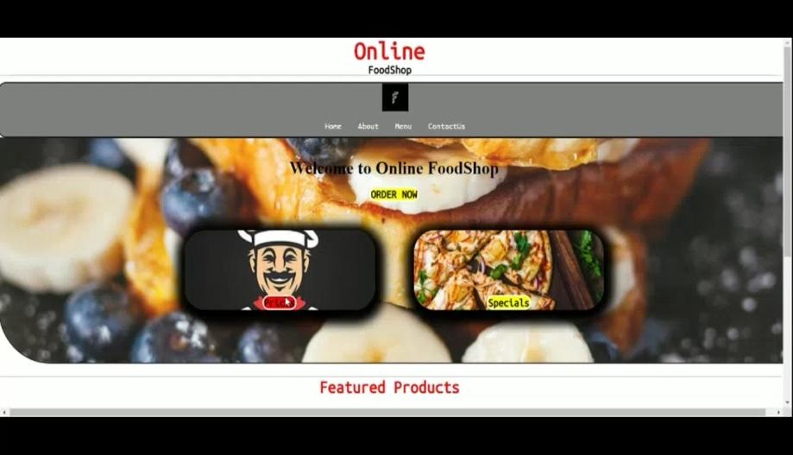

Slide 23
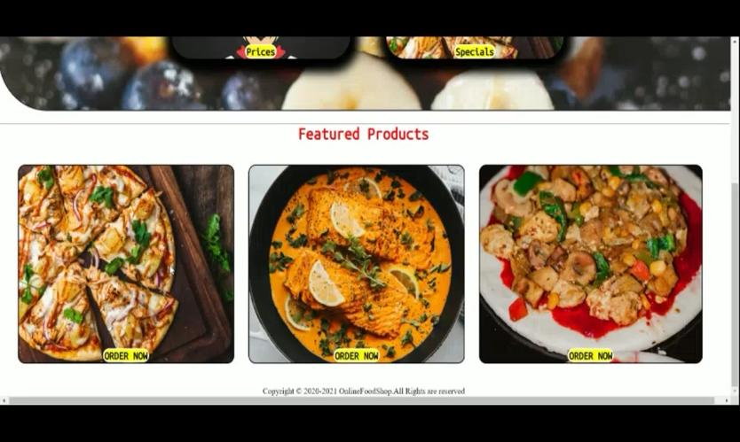

Slide 24
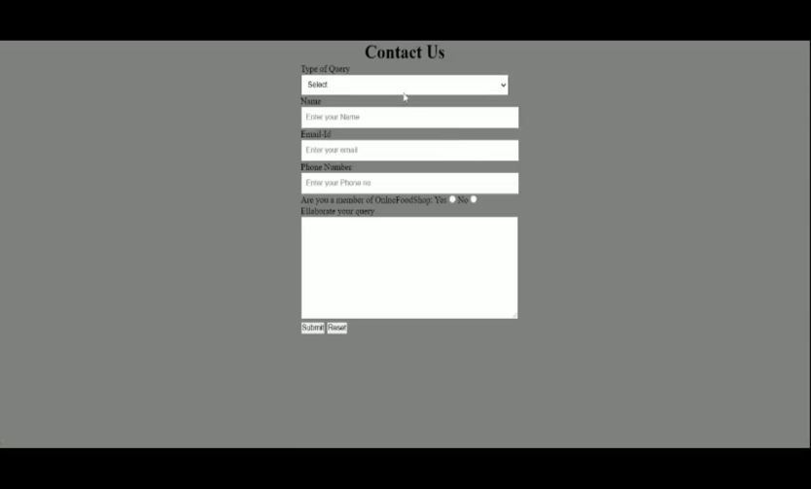

Slide 25
In conclusion, front-end development is a critical aspect of web development that involves designing and developing the visual and interactive components of a website. It requires knowledge of HTML, CSS, and JavaScript, as well as an understanding of user experience (UX) and user interface (UI) design principles.
The front-end developer is responsible for creating an engaging user experience by designing and implementing the layout, typography, color schemes, and graphics of a website. They also ensure that the website is responsive and accessible across multiple devices and platforms.

Slide 26
Front-end development is a constantly evolving field, with new technologies and frameworks emerging regularly. Therefore, it is crucial for front-end developers to keep up with the latest trends and developments in the industry to create modern and functional websites that meet the needs of users and businesses alike.

Slide 27
In summary, front-end development plays a crucial role in creating visually appealing and engaging websites that attract and retain users. With the right skills and knowledge, front-end developers can create effective user interfaces that provide an exceptional user experience, thereby contributing to the success of a website and its business.

Slide 28
Submission Github
https://github.com/sundark14/food-delivey-website.git

